Slide 2
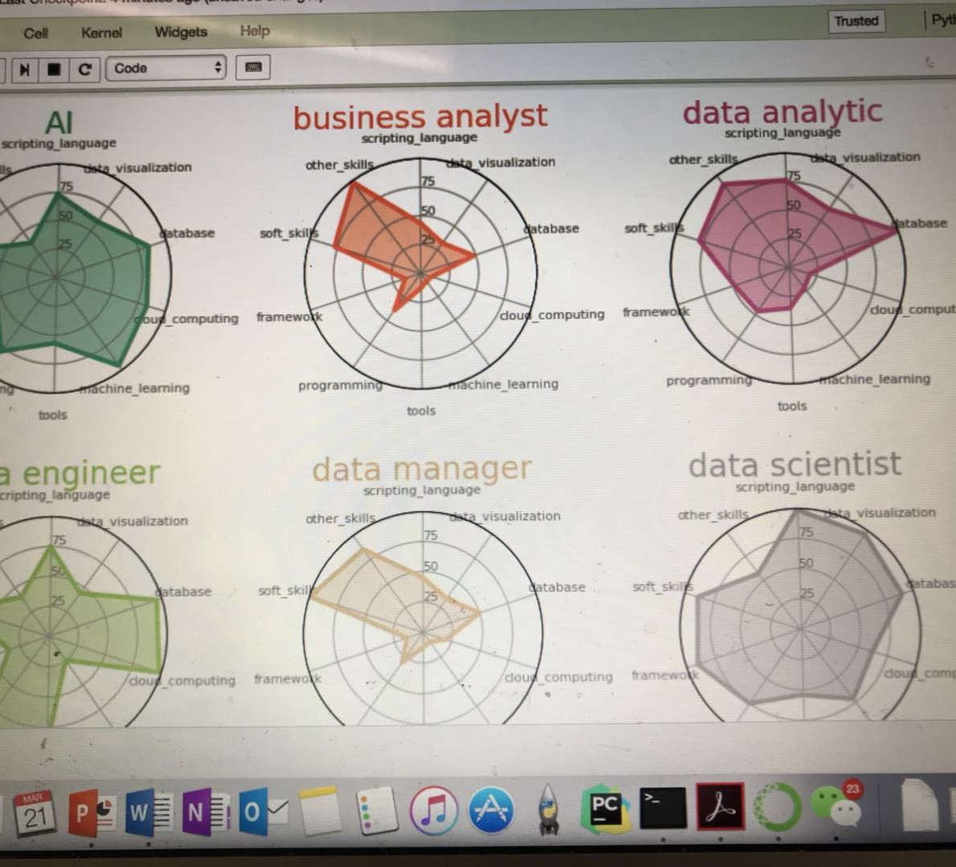
Notes:
To understand what courses are needed for Master of Data Science and Analytic and Master of Management in Analytics and AI, We assume when students graduate from MDSA will look for jobs with titles similar to: Data Analyst, Data Scientist and Data Engineer. Students from MMAA will look for job titles similar to: Data Manager, Business Analyst and AI systems designer. We then collect around 300 course titles from 14 Master programs from North America, divide them into 7 group, each representing different area of skills. The areas are: programming languages, statistics, algorithm, machine learning, data visualization, communication and soft skills, business and management. Then we use word frequency to rank the importance of the 7 area of skills to each of 6 different job titles. Then we could tell for what courses are important to MDSA and MMAI program, therefore we can design required course and elective course for each master program.

